Slide 1

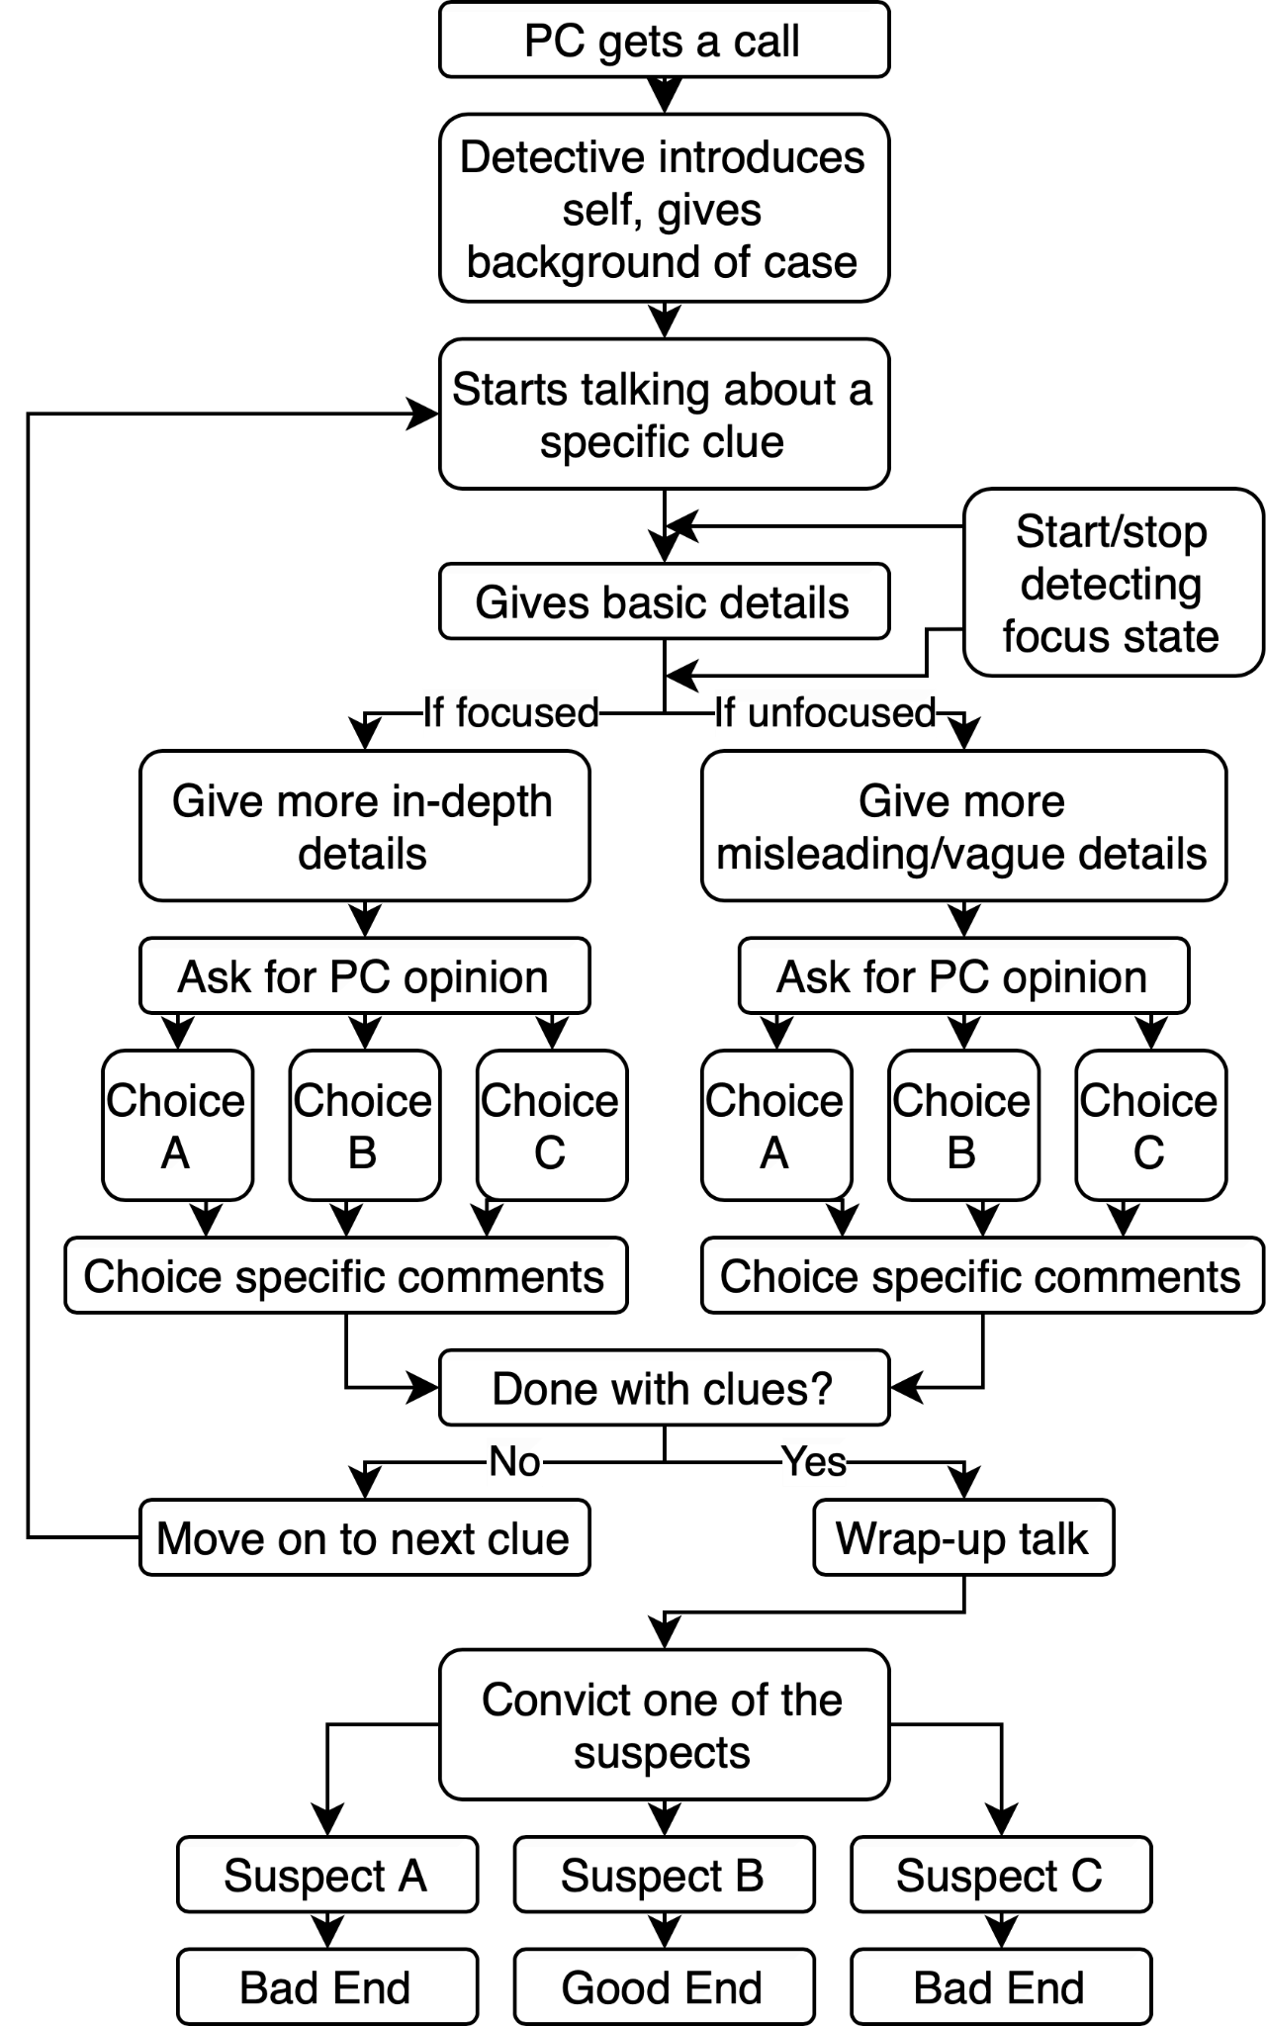
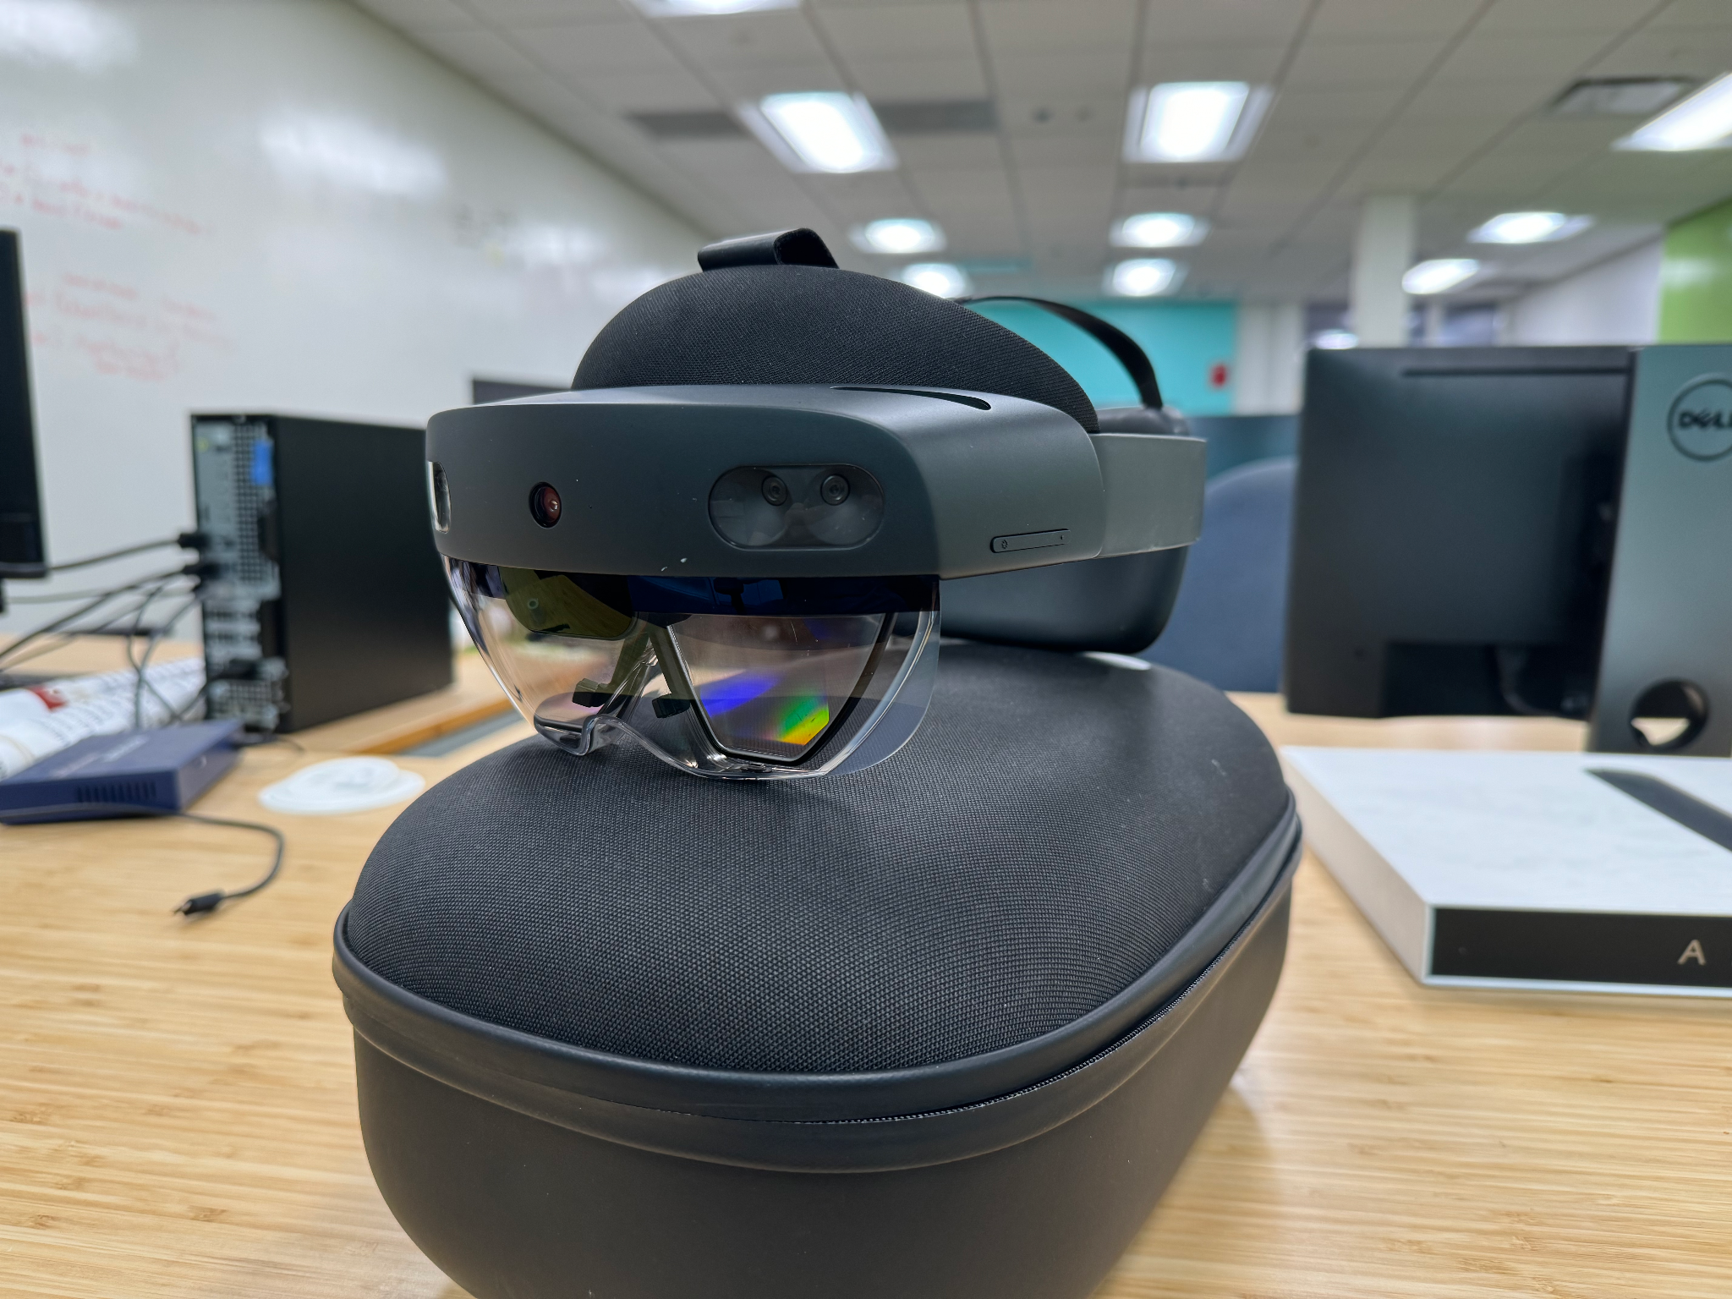
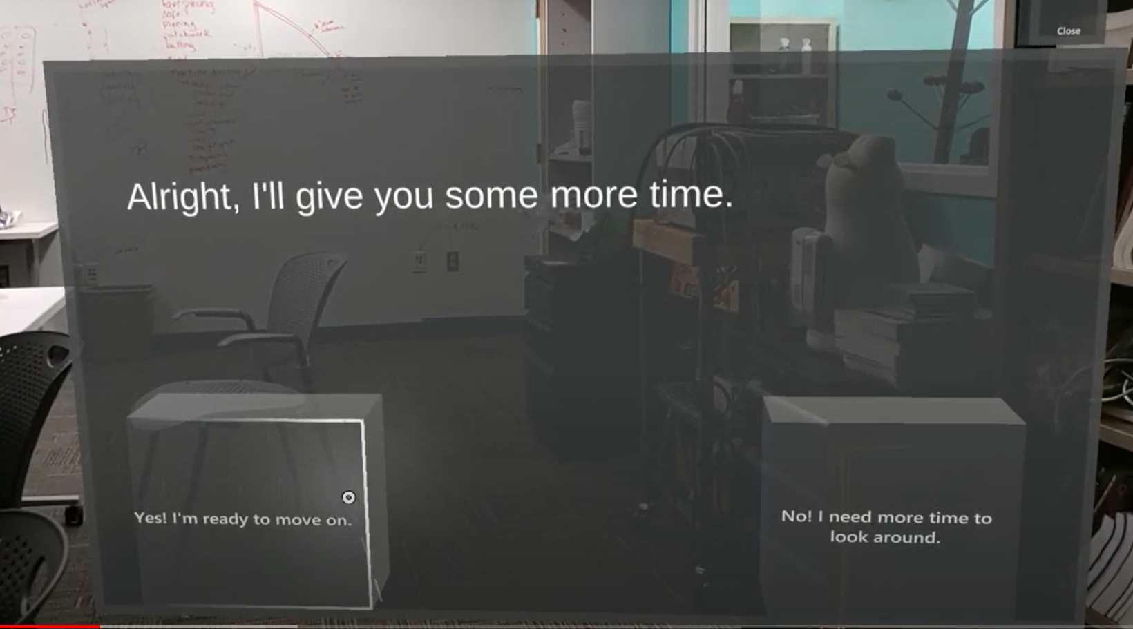
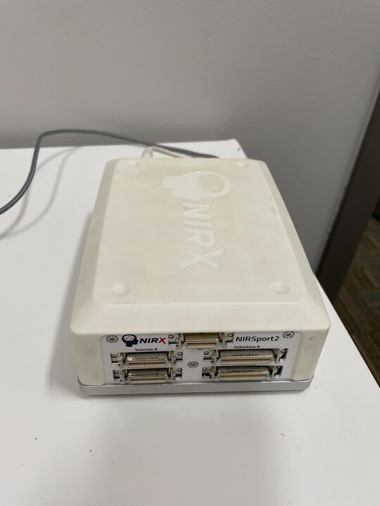
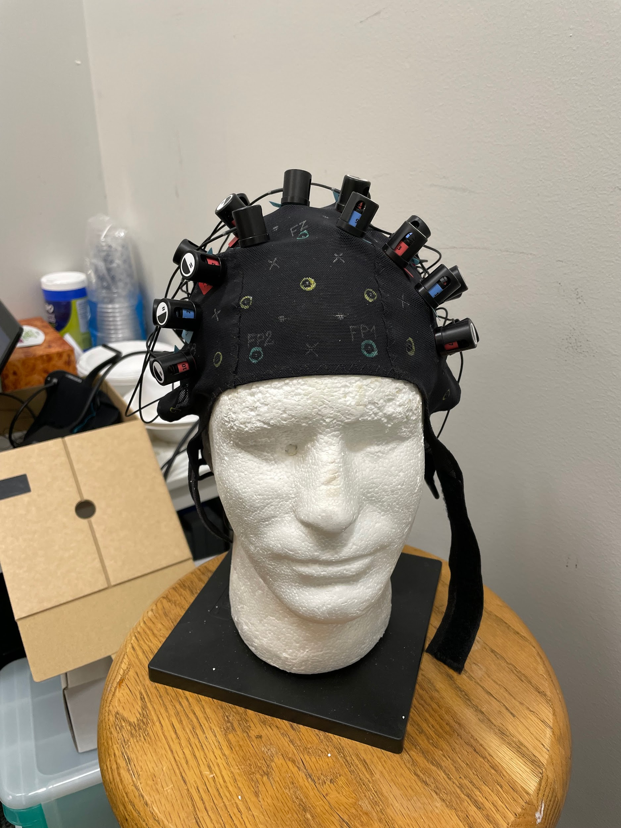
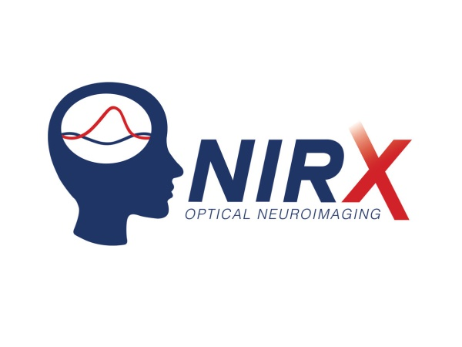
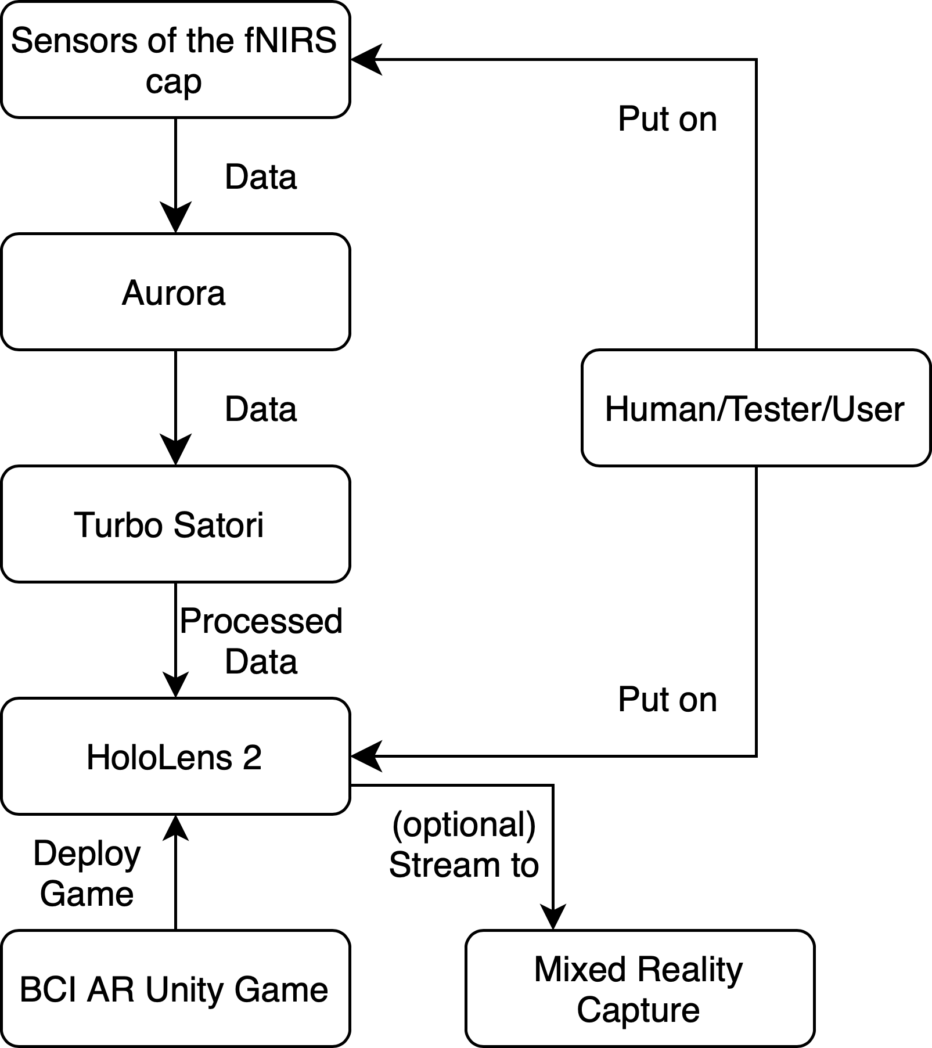

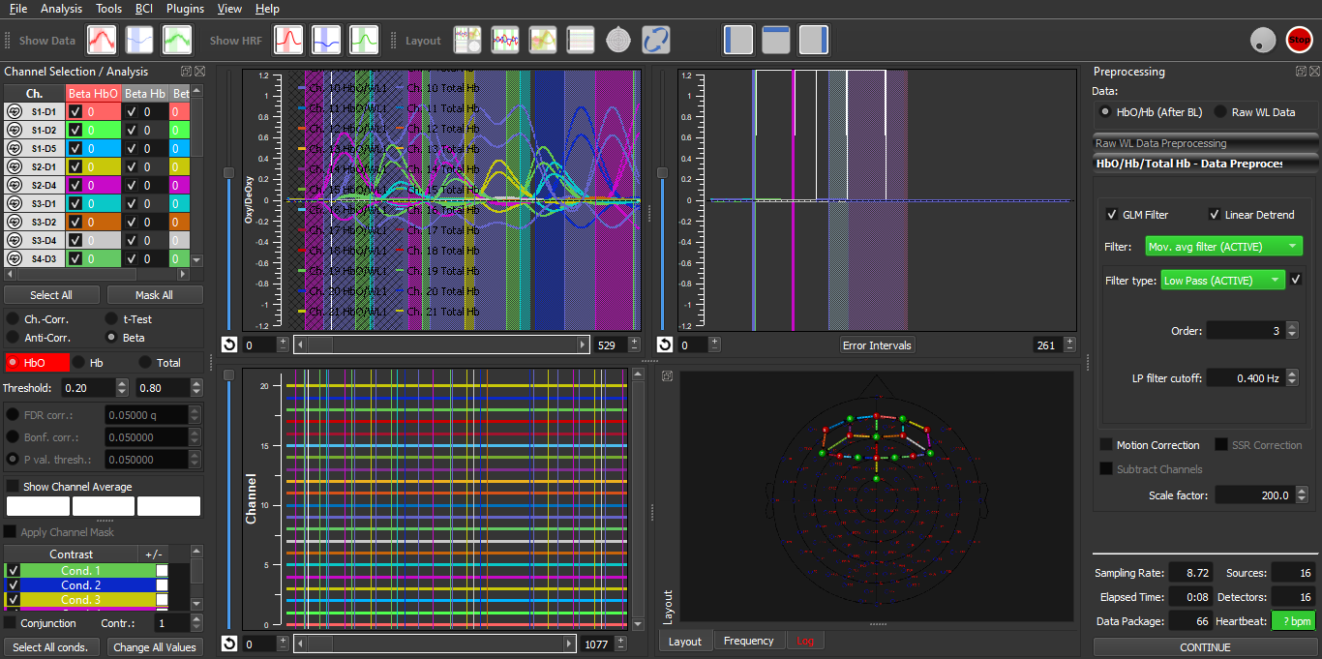

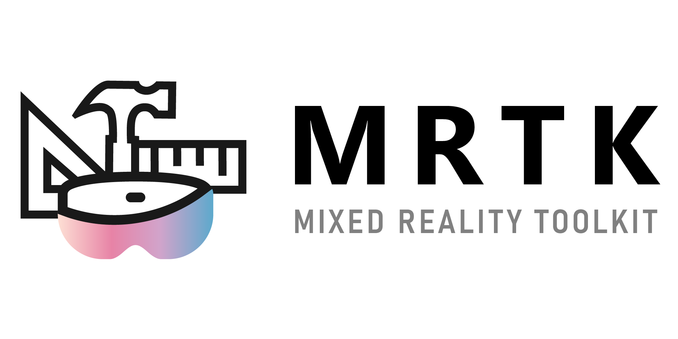


Developing a Brain-Computer Interface to Enhance Storytelling in Games with the Identification of Cognitive States
James Cao (CS), Andrew Nguyen (CS), Jagger Polvino (CS)
Faculty Advisors: Gillian Smith (CS/IMGD), Erin Solovey (CS)
PhD Student Advisor: Max Chen (IMGD)
Introduction
Brain-computer interfacing (BCI) is a field that has developed significantly within the past few decades and has numerous applications, primarily in medicine and research. Another less explored field of application for BCIs is in entertainment, specifically video games.
The goal of this project was to establish an infrastructure for the future development of AR games that adapt their narrative style based on cognitive data retrieved using fNIRS and identify avenues of development as well as challenges involved with integrating brain signals into a game. Our areas of background research included fNIRS, augmented reality, HoloLens, and game storytelling.
Story Tree
Game Equipment and Game View
We formatted the story script into a CSV file where the story progressed row by row
The first column of each row would state what purpose the row would have
CSV is read row by row to determine the action taken
Row types:
dialogue for printing text to main screen
choices for players to select
state for prompting the player if they are focused or unfocused.
The diagram on the right shows the progression that the player would go through while playing the game
fNIRS
Functional near infrared spectroscopy
Noninvasively detects oxygenated/deoxygenated hemoglobin levels in the brain (HbO/HbR)
Using a headset with probes/sensors, shines harmless near-infrared wavelength light into the head, which shines through most living tissue. Hemoglobin absorbs the light, and blood concentrations determined by the levels of light reflected/detected back
Devices/sensors used for fNIRS:
NIRSport2 (NIRx)
NIRS cap & probes (NIRx)
Software used to obtain, organize, and preprocess fNIRS data:
Aurora fNIRS
Turbo Satori (simulation screenshot below)
Results
We created documentation on how to connect TSI to Unity, read data from TSI in Unity in real-time, as well as connecting Unity to HoloLens
We created a murder mystery game, set in 1930s London, that offers players a classic "whodunit" experience
The player acts as a consultant aiding a detective’s investigation of the 3 suspects
Scripted narrative interspersed with clues, where the player’s focus levels (derived from HbO/HbR concentration) influence the accuracy of information provided and create branching text options, enhancing the interactive puzzle-solving experience
Heightened HbO/HbR concentrations indicate increased metabolism caused by neural activation/increased focus
We connected all devices and software together to form a complete flow of BCI data from the fNIRS headset to our game on a HoloLens device
fNIRS Flow Diagram
All data is transferred through a single wireless private network
Aurora connects to NIRSport/NIRS cap and probes
Configure the montage (probe positions) to read from
Data is then streamed to Turbo Satori for preprocessing
Unity code (on HoloLens) sends TCP requests every 2 seconds to Turbo Satori for HbO/HbR data from specific probes/channels
Unity code analyzes received data and processes it for use
If probe/channel values are above/below a certain value, the user is considered focused/unfocused
Future Work
Expand the existing game
Add more to the story
Develop a more aesthetically pleasing UI
Further implement focus state affecting gameplay/story
Create a custom montage for fNIRS
Ensure no overlap between NIRScap and HoloLens 2
Links
Project GitHub:
To view our project code, scan the QR code
Game Demo:
To view a video demo of our game, scan the QR code

